Slide 1

CA22123 EU-MACE: Core Group monthly update #5
Virtual
08/10/2024

Slide 2
meeting Agenda

Slide 3
To new members: at the monthly update meeting …
Overview of the current status of EU-MACE
Different Tasks in progress
Action immediate needs and how you can contribute!
Upcoming actions
How you can contribute and whom to contact
AOB of relevance

Slide 4
0. Ice breaker
1st AAC
1AAC summary
MC meeting
WGs & International session
MC e-vote
Activities since 1AAC
PR1 report
Recent Actions
Financial report and budget
Next steps
WG leader and task leader position mandate
Next Action monthly update meetings
MC (and core group) meeting, WG meeting
GP2 sneak previews
Additional notes
Post-presentation discussion points
Extra details to accompany the presentation

Slide 5
1st AAC summary

Slide 6
1st annual Action conference
September 4-6, 2024 @Uni. Cyprus (L.O. = Theodora Kyratsi)
Day 1: CG/MC meeting (16/29 countries) + WG3 workshop (17 in-person attendees)
Day 2: WG1 MAP presentation + International networking (21 in-person & +100 online)
Day 3: WG2 MAP presentation + round-table discussion (17 in-person & +40 online)
MC meeting minutes distributed among MC members
https://filesender.renater.fr/?s=download&token=203c0cc7-ba2a-4244-a0cc-1a6a8761349e

Slide 7
1st annual Action conference: WG3 workshop
TDM workshop (K. Malek) on 3 materials selected via online meetings and suggestions by members
Solid electrolyte polymers (A. Szawiola)
MOFs (D. Kriechbaumer)
No-PFAS (K. Malek)
TDM template per material class containing – Technology description/technical targets @material, components, unit and system levels)
Worked on « Technology description » in groups to define promising applications
Core groups formed to fill in the TDM template
Solid electrolyte polymers (A. Szawiola + A. P. Sanjuan + S. Nakamae)
MOFs (D. Kriechbaumer + O. Ozcan + A. Occhicone)
No-PFAS (K. Malek + M. Fabrizio + T. Inan)

Slide 8
1st annual Action conference: WG3 workshop
Next steps
Selection of applications (2 app’s/material class)
another round of online session with core group
Distribution to WG3 and Action with an explanatory message, include:
Construct core WG members
Set timeline
Complete the TDM analysis in GP2
Produce « position paper » for building MAPs for the selected material class (for specific applications in mind)
Interested? Contact: Saco, Kourosh, Anjuli and Dorottya
Some of you will be contacted by us.

Slide 9
1st annual Action conference: WG1 session
MAP presentations
Leah Nuss, TUM (in person)
Stefan Edinger, AIT (online)
Alexander Colsmann, KIT (online)
Gun Deniz Akkoc, FZJ (online)
Simon Stier, Fraunhofer Society (online)
Sebastian Siol, EMPA (online)
Presentations 3 through 6 are recorded ➔ being cleaned
Presentation 1 : file provided
Presentation 2 : file to be provided (need to ask)

Slide 10
1st ann. Act. conf: International networking
Organization/program/network presented
Sawako NAKAMAE, COST Action EU-MACE (in person)
Prof. Kevin Rossi, COST Action: DAEMON (in person)
Prof. Roberto Iglesias, COST Action: EU-MINE (online)
Dr. Anna Maria Christoforou, Cyprus/EU representative (in person)
Prof. Jasna Jankovich, REACH2 : H2 MAP network, USA (online)
Dr. Fanny Balbaud – DIADEM, France (online)
Prof. Venizelos Efthymiou, EU RI project: RISEnergy (in person)
Dr. Massimo Celino, IEMAP, Italy (online)
Dr. Lorenzo Malerba – CONNECT-NM (online)
Dr. Francesco Matteucci - EIC & IAM4EU co-programme
All presentations recorded ➔ under cleaning

Slide 11
1st annual Action conference: WG2 session
MAP presentations
Dr. Fanny Balbaud – A-DREAM/DIAMS, CEA (online)
Prof. Katerina Christofidou – Henry Royce Institute (recording) + Dr. Richard Dawidek
Dr. Janne Pakarinen - VTT (online)
Dr. Özlem Özcan Sandikcioglu - BAM (online)
Dr. Jaroslaw Jasinski – NOMATEN, NCBJ (in person)
All presentations recorded ➔ being cleaned
MAPs accepting STSMs

Slide 12
1st annual Action conference: round table
What actions for EU-MACE in GP 2?
Online webinars combined with monthly update meeting (every other month) ➔ see p. 28 for more details
More technic-focused online workshop
Improve - Industrial involvement (will require the members’ contribution) ➔ survey on who has contacts with which industries?
Proposition for training school co-organization (with CONNECT-NM, for example 2026)
Other networking models, e.g., organization of online workshop for students
Add Equipment mapping to the MAP/Expert list
Future LabLive participation (member MAP/Lab/project promotion) ➔ MC e-vote validated
Promotional video making (member MAP/Lab/project promotion)
Future projects (infrastructure, legacy labs, etc.) discussion
How to spend more money quickly?

Slide 13
Since 1AAC

Slide 14
PR1 report
PR1 report
Only a few questions on COST Excellence (inclusiveness)
Young researcher involvement (we are doing well, except for leadership roles)
ICT member involvement (we are doing well, except for leadership roles)
Gender balance (we are doing well, except for leadership roles)
What we will do to improve
To address: How to increase ICT, young, female members involvement in the leadership roles. (will share the AC’s answers with MC/CG members)

Slide 15
Recent Actions
Suggestions by COST Action officers responding to our under-spending*
Dissemination conference grants
CONNECT-NM kickoff meeting by S. Nakamae (October 2-4)
Hydrogen conference in Australia by A. Laikhtman (September 4-6)
EU Big-Data Forum (October 2-4)
K. Malek
M. Popp
C. Kreisbeck
STSM grants (emails sent earlier this month)
Visiting BAM
G. Cempura (happening now)
B. Postolnyi (Next week)
Roll-up banner made
Possibility to pay in advance Future Lab Live 2025 ➔ CA officer’s reply received: NO!
*due to: 1) GA amendment signature delay, we could not organize inter-Action meeting
2) 6 cancellations for 1AAC in-person attendance
3) 2 STSMs instead of 6

Slide 16
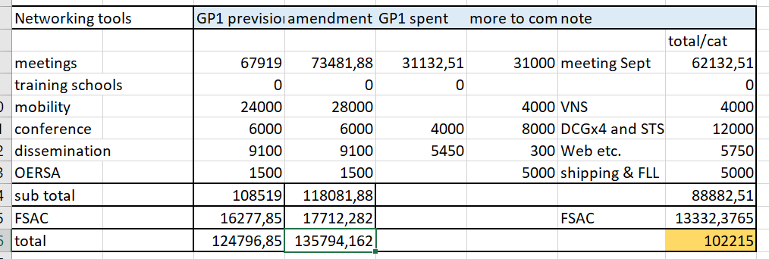
Financial reporting
GH manager and AC are working on it!
We will do better next year by early planning

Slide 17
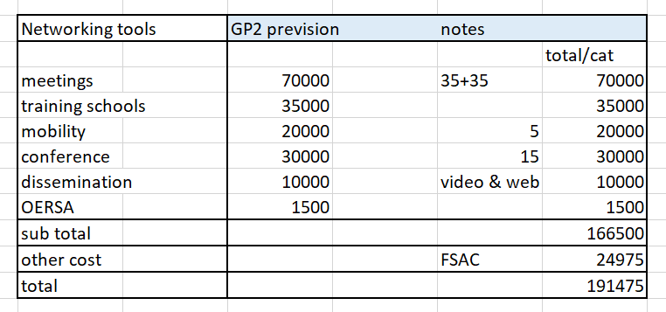
Budget plans
GH manager and AC are working on it!
We will do better next year by early planning !!

Slide 18
Future actions

Slide 19
WG & Task leader mandate
In MC1 meeting, we have decided to change WG/Task leaders (if needed) @M12 AND we must increase the participation of ICT, young & female members participation
WGs & Task | current | Next GP
WG1 – perovskites | Helge Stein (DE)
WG2 – metallic alloys | Jarek Jasinski (PL) | Jarek Jasinski (PL)
WG3 – New materials | Kourosh Malek (DE) | Kourosh Malek (DE)
WG4 - training | David Lacroix (FR)
WG5/Communications | I. Matejak (BE) | Gloria Botton (BE)
Grant Award committee | Holger Ihssen (DE)
Sustainability | G. Campana (IT) | Giampaolo Campana
Inter-COST Action actions | Saco Nakamae (AC/FR)
Training school | David Lacroix (FR) | David Lacroix (FR)
(Erasmus)
EUROMAT2025 | Theodora Kyratsi (CY) | Theodora Kyratsi (CY)
MAP & EXP List/database | Kourosh Malek (DE) | Kourosh Malek (DE)
New leadership positions? | Industrial relations, webinar organization, etc.

Slide 20
Next meetings/discussions
Action monthly meeting: November 12, 2024 ➔ November 13, possible?
If interested in the leadership positions, please email me and state your contribution propositions
New leadership candidates will be presented
Finalized (but not yet approved) financial report will be presented
Budget plan presentation (to be voted by MC members)
MC meeting: (late) January 2025 – in person, 1 day! Brussels? Ireland? Portugal?
New leader presentation
New actions (webinar, student workshop, legacy labs etc.)
WG and Task progress reports
WG3 meeting: (online) When?
Selected members only for advancing with the TDM

Slide 21
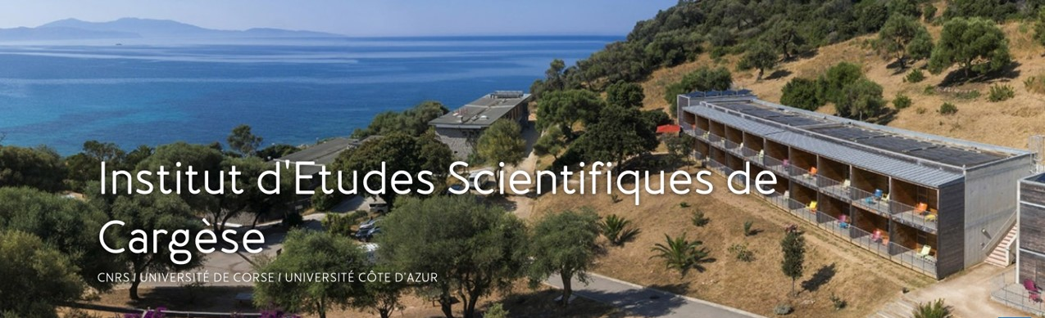
TOTEMIC 2025 training school
Tools for Energy Materials Modelling Acceleration Training school
April 20 – 26, 2025
Cargèse, Corsica, France
Joint organization with CNRS (France) GdR NAME
Co-chair from EU-MACE : David Lacroix
Material for energy ; added value of IA (application field : battery, fuel cell, catalysis, carbon capture, etc.).
Nano & micro material design for tailored properties; advantages of using high throughput and screening techniques.
Machine learning driving sustainable material development (life cycle, critical materials, material reliability, ageing, in operando behavior, etc.)
AI tools and material acceleration platforms; how embed data (operability/readability/etc.) to improve experimental research
Material informatics ; AI techniques devoted to multiscale, from the material to the system

Slide 22
TOTEMIC 2025 training school
Structure and EU-MACE participation
50 – 80 attendees
10 invited lecturers (covered by EU-MACE)
15 invited students/YRIs (covered by EU-MACE)
700€/person (to be determined) accomodation fee covers lodging and food
Travel cost according to one’s needs
Announcement and the first call of abstracts to appear in November
Lecturers from EU-MACE
Scientific committee from EU-MACE
David Lacroix
Sawako Nakamae
Antonio P. Goncalves
Rafael Mayo Garcia
Roberto Iglesias
Theodora Kyratsi
Theodore Karakasidis
Janne Pakarinen
Monica Fabrizio
Iosif Galanakis
Michael Eikerling (Aachen) – plenary lecture
Kevin Rossi (Delft)
Ozlem Ozcan (BAM)
Kathy Christofidou (Royce) – to be confirmed
Filippos Sofos (U. Thessaly) – to be confirmed
David Lacroix <david.lacroix@univ-lorraine.fr>

Slide 23
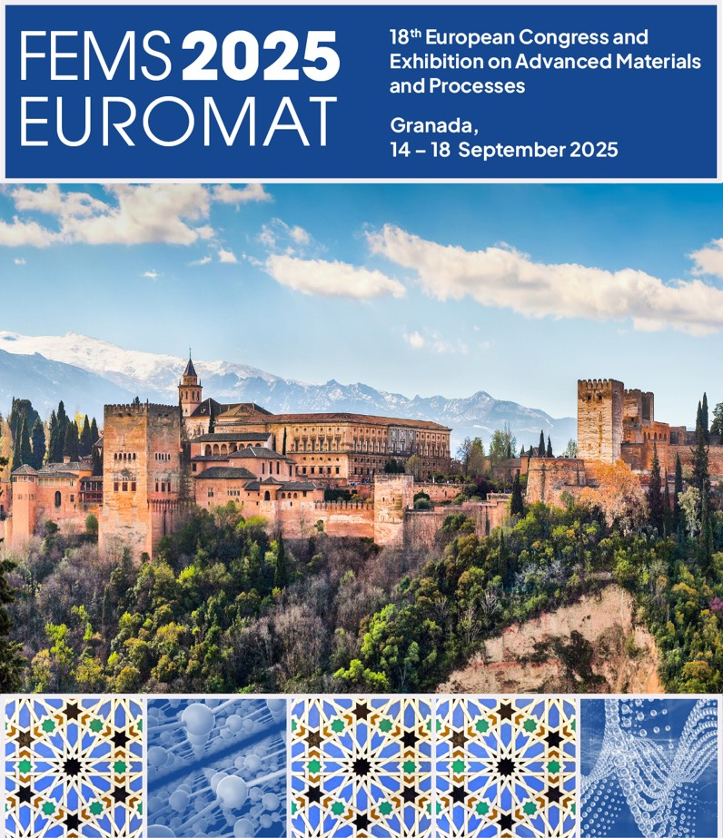
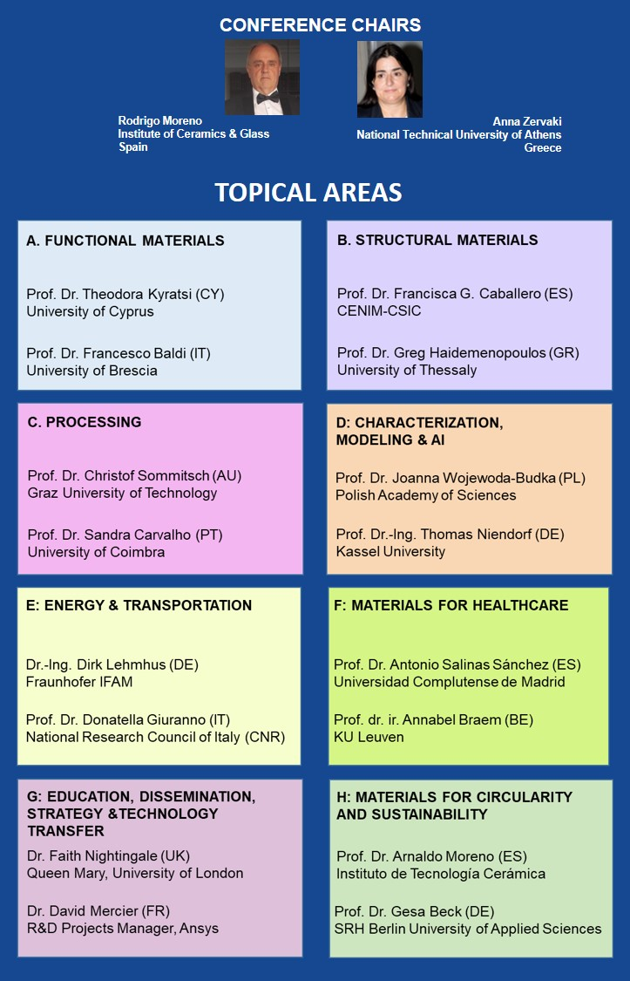


Notes:
23

Slide 24
EUROMAT 2025
Topics, organization, etc.
50 – 80 attendees (hybrid)
1 day before the conference start
Independent registration
Can support ~20-25 attendees for the forum (but not the conference)
Special provision for 5 YRI’s conference grants (2000€ each)
Topics ➔ details on proposed sub-topics and stakeholders on p. 29
Organization committee from EU-MACE
Theodora Kyratsi
Antonio P Sanjuan (local organizer)
Jaroslaw Jasinksi
Monica Fabrizio
Holger Ihssen
Sawako Nakamae
Erika Hodulova
Accelerated device integration: by unifying digital and materials competency (Increasing SDLs & MAPs capacities via horizontal collaborations)
Continued growth (Further education). Adapting one’s ‘traditional’ training to the fast-changing dynamics toward the digital-driven and holistic research approach is a formidable challenge faced by many senior investigators.

Slide 25
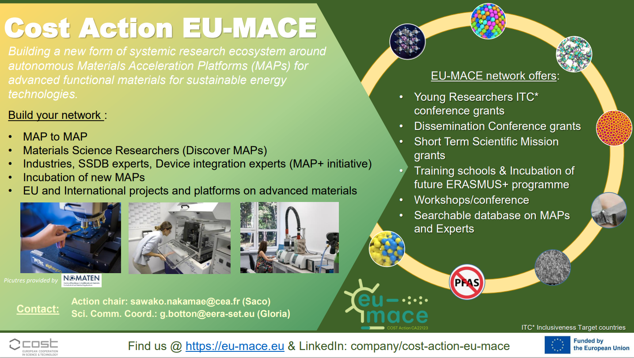
WG2 (complex alloys) update: Jaroslaw/NCBJ (PL)

Slide 26
Thank you for your attention !!

Slide 27
Notes from discussion during the meeting
Increasing the involvement of YRIs: Creation of YOUNG EU-MACE task force (sub-group) to encourage YRIs to network, for example through organizing a workshop (could be a session during the MC meeting)
Enhancing Industrial involvement:
Prepare a model ‘advert’ to be used for introducing EU-MACE to potential industrial partners. (background: some members are contacted by industries for their technical expertise. It would be useful to have a flyer, or even a short example message that they can include in their correspondences for disseminating our Action. The potential industrial members can be solicited to give a talk at one of our meetings/workshops/schools, or sponsor our event)
Create: Network for business model for accelerated device development for industries. (background: Devices have many complex components that are intricately connected to one another. Developing such structures is beyond the technical capacity of a single industry. Industries can connect with EU-MACE members’ MAPs, labs offering off-line (from MAP) characterizations, and the knowledge on agent creation for setting up new device developments.
Funding opportunities:
Bespoke ‘network creation’ with orchestrating agent is constitutes a new project requiring funding (cannot fund within EU-MACE). But our Action can act as an incubator
EU program scouting for suitable calls: business model network for industries; legacy labs; infrastructure project, etc. This may be done within each WG.

Slide 28
Additional details on presentation items
About the online, bi-monthly webinar (Each WG is represented every 6 months)
The webinar should be scientific and rotate among WGs ➔ to be named “coffee with EU-MACE”
YRIs within or outside of Action can be invited
Should further discuss
Who invites and how to choose topics?
Format example: 1 presentation (45”) + discussion (15”)
Industries can also be invited
Topic ideas (should correspond to Action objective: building materials ecosystem/entire value chain)
Science: technical & research challenges in alloys, perovskites … new materials
Gaps: between different stages of value chains
How to accelerate materials research on alloys, perovskites, new materials; e.g., How to incorporate ML into traditional research, step-by-step guide toward automated and autonomous research design.

Slide 29
Additional details on presentation items
Topics, audience and stakeholders at EUROMAT 2025
Accelerated device integration : How do advanced, functional (new or improved) materials find their way into technology?
Stake holders:
SMEs specialized in prototyping : how to find such companies? How do they design, build and validate prototypes? What are the following stages in the innovation chain?
Digital twin specialists (overlap with point i above): who are they? How to contact them?
Funding sources: Device development costs money. Who invests money into this innovation step? Public and private funding schemes, where to find venture capitalists and what are the key criteria they use to determine in which materials/devices to invest/fund?
Audience: researchers, educators, students, industries
Continued growth (Further education): How to liaise local, isolated experimental/numerical practice to MAPs?
Stake holders:
Energy materials researchers whose methodologies do not include automation, AI assisted analysis/simulation, high-throughput characterization, or sustainability analysis… etc.
Automation specialists, ML software developer, LCA scientists
SMEs who want to assist in building prototypes, or benefit from Action partner labs
Can be made into a project matchmaking session that participants sign up beforehand to present their R&D ambitions

